Slide 1

MBP
TEAM

Slide 2
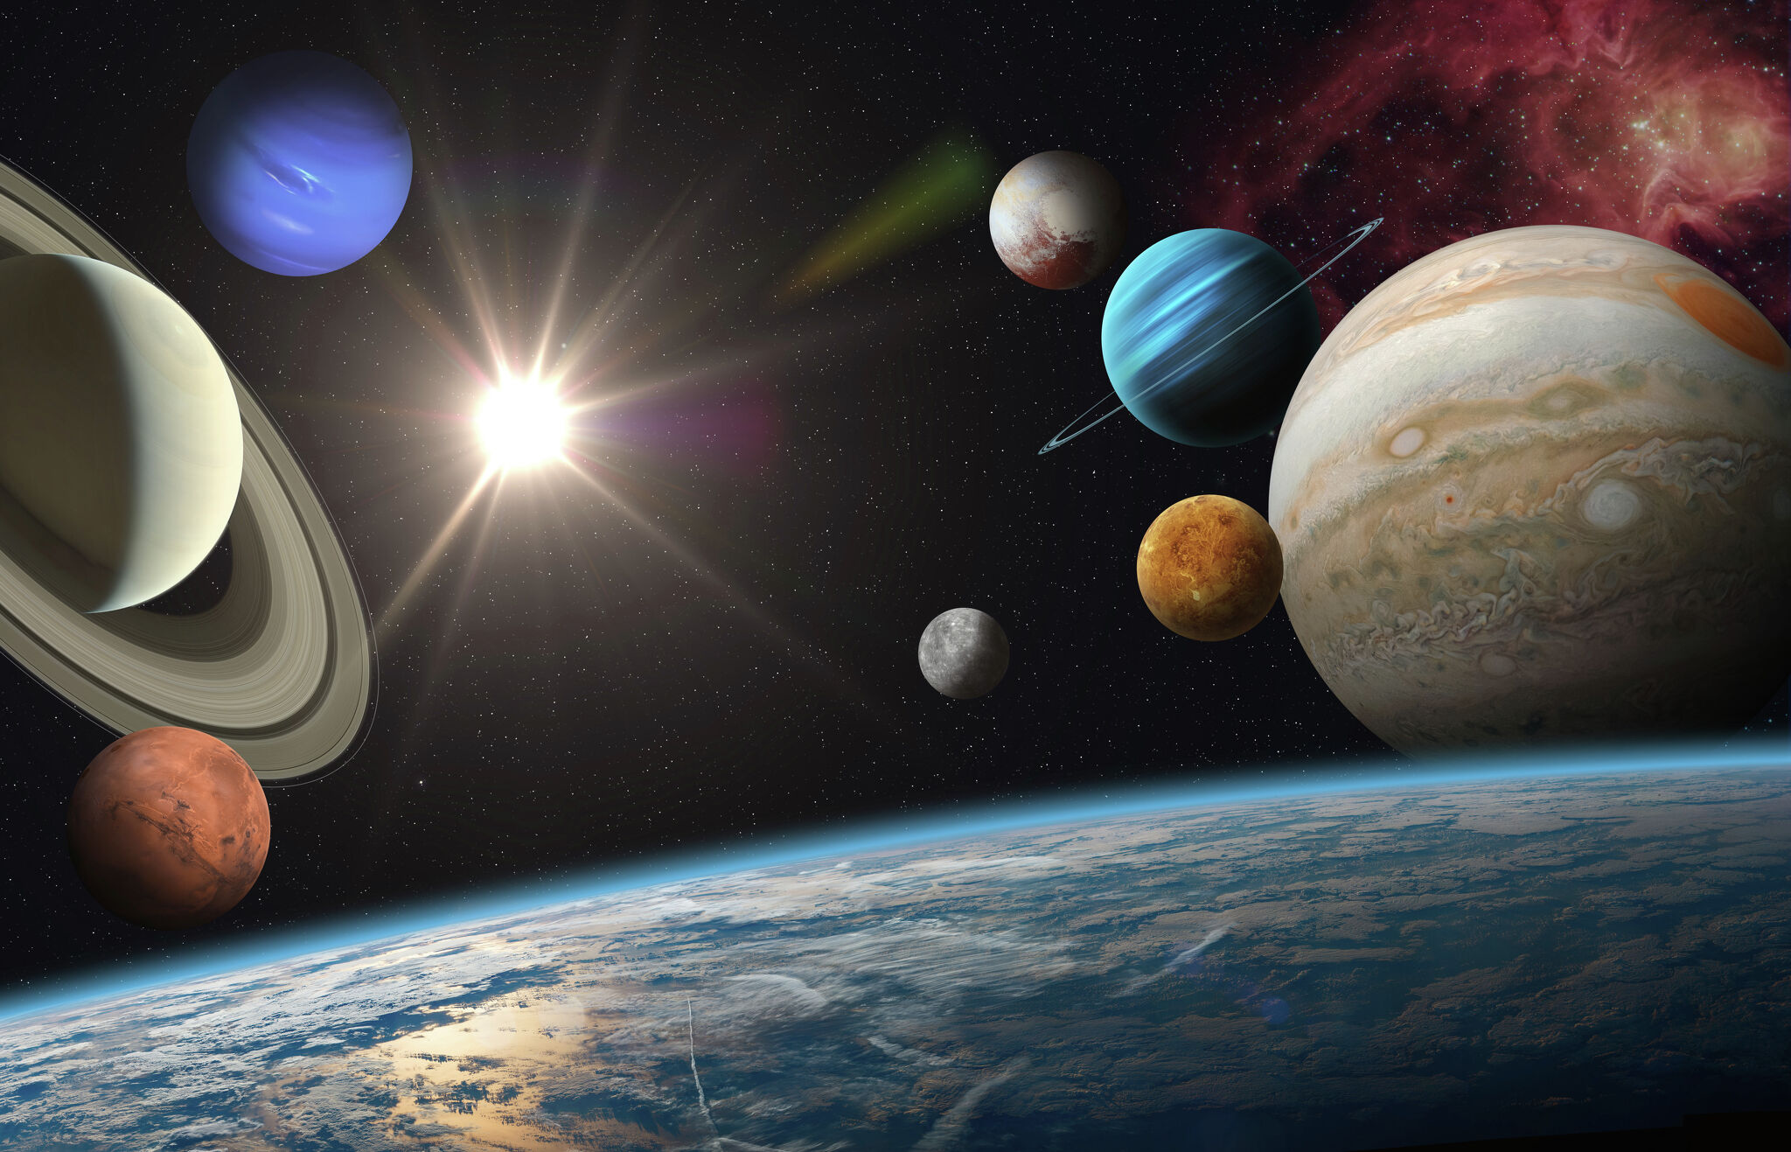
Contents
About us
Out team
Tech Stack
Implementation

Slide 3
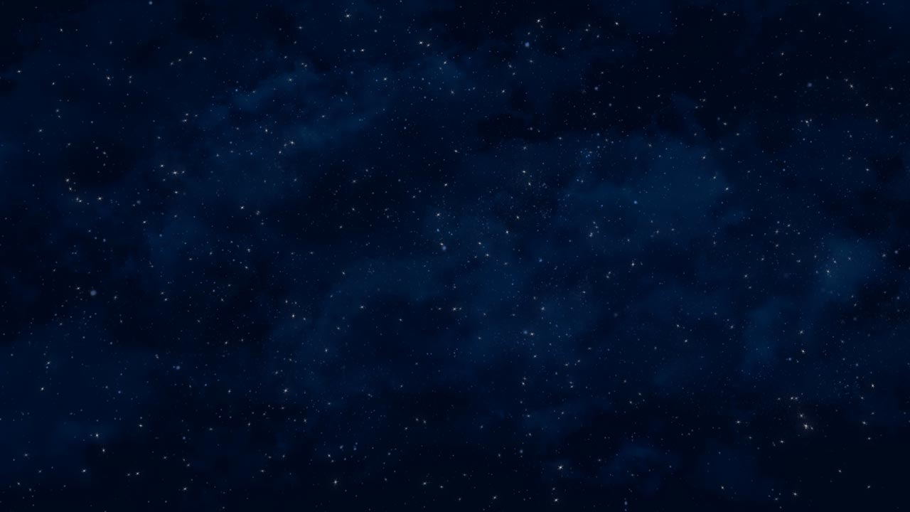
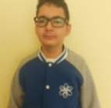
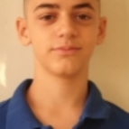
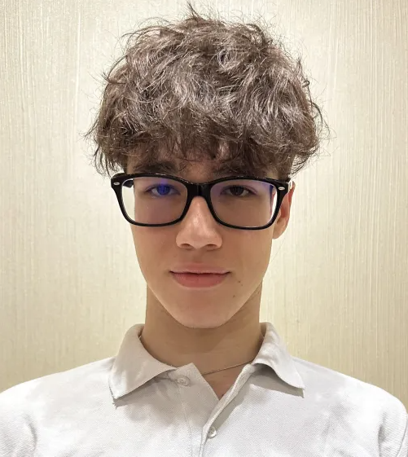
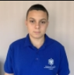
Our team
Stanislav Radev
Back-end Developer
Boris Rusinov
Back-end Developer
Alex Semerdzhiev
Back-end Developer
Milko Barev Scrum Trainer

Slide 4

The idea
The goal of our project is to make something fun that can educate you .

Slide 5








Tech Stack

Slide 6
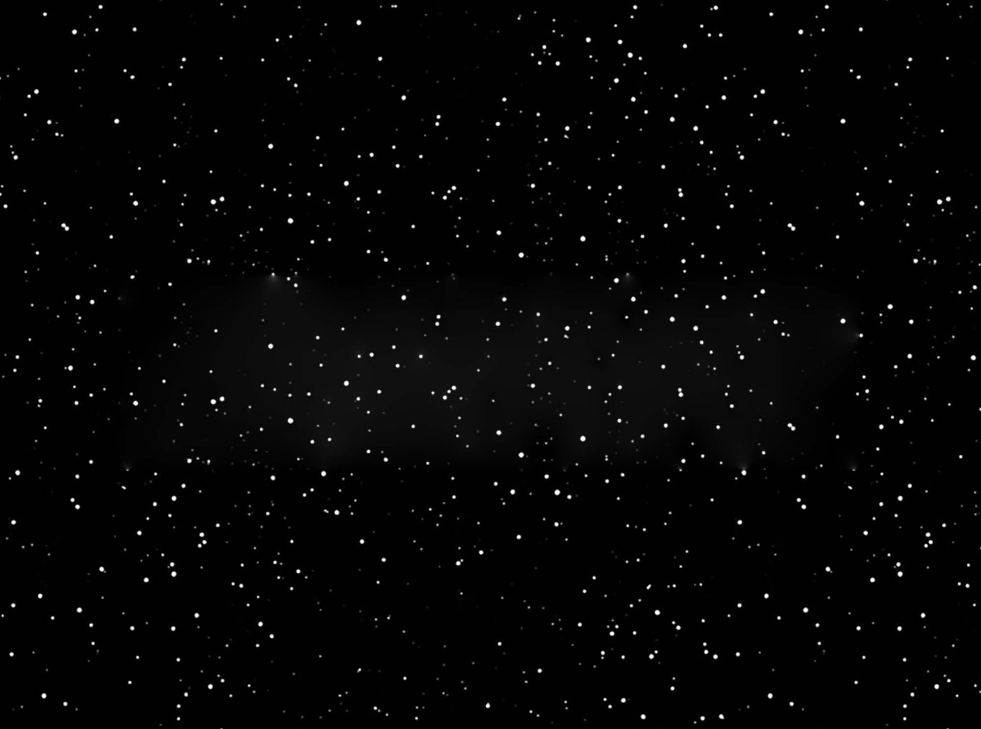
Implementation
We built our application from the ground up in the span of three weeks, meaning that our project will hopefully be deemed successful.
This time around though, our time for set up and organization could have gone better. That however didn’t discourage us from working stably throughout the rest of our given time.

Slide 7

Thanks for listening!

